Slide 1

VIRTUAL INTELLIGENCE SERVICE
VICTORIA PER INTELLECTUM
SYRIAN INTEGRATED AIR DEFENSE SYSTEM
INTREP VIS-OPAR-002
DRAFT
DISCLAIMER:
This is for multiplayer online gaming using the Digital Combat Systems simulation software published by Eagle Dynamics. The information is not in any way suitable for real world use or operations.
Version: X.X
Published: YYYY-MM-DD

Slide 2
INTRODUCTION
A
A
Aim:
This report intends to present information on the Syrian IADS, how it functions and critical target components.
Reference:
INTREP VIS B-001 Generic Ground Force Structure v1.0
Content:
Part 1: General IADS information
IADS
Command Centre
SAM Site
Early Warning Radar
Connection node
Power supply
AWACS
Air Defense Fighters
IADS Tactics
How to neutralize IADS
Part 2: Syrian IADS
Syrian IADS organization
B
B
C
C
D
D
E
E
F
F

Slide 3
PART 1: GENERAL IADS INFORMATION

Slide 4
Integrated Air Defence System (IADS)
An Integrated Air Defence System (IADS) is a wide network of surface-to-air forces that work together to defend the skies of a specific area. The system is also connected to the fighter aircraft in the A-A role either in a airborne CAP or intercept aircraft on ground alert that can be scrambled toward incoming threats.
There are several elements that are part of this network, which all will be explained more in detail in the next slides:
Air Defense Command Centre
Early Warning Radar (EWR)
SAM Site
Sector Command Centre
Power source
AWACS
Air Defense Fighters
Example:
The illustration to the right show a simple IADS. Each sector have a EWR that feeds information into a sector command centre. SAMs are off, and only turn on to fire based on the information from the EWR that they are within range. In addition, as long as the sector is connected to the entire IADS, they can also be activate based on other EWRs in IADS. AWACS is also supporting and contributing via the command center and functions as a extra EWR. Fighters on standby can also be launched to either sector based on radar information from EWR or AWACS.
SECTOR A
SECTOR B
A
A
B
B
SAM 2
SAM 5
C
C
D
D
SAM 1
SAM 3
SAM 4
SAM 6
Sector Command Centre
Sector Command Centre
E
E
F
F
EWR A
EWR B
Air Defence Command Centre
AWACS
EWR Center
Fighters
Back

Slide 5
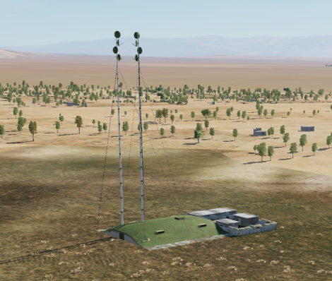
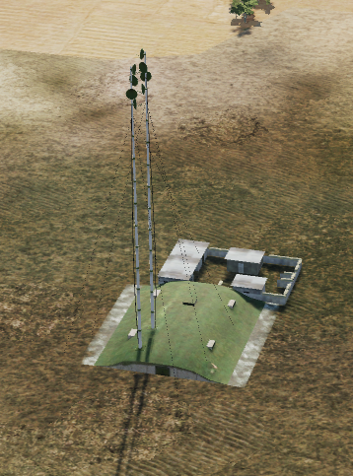
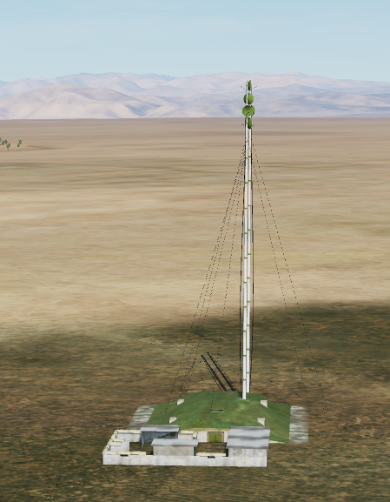
AIR DEFENCE COMMAND CENTRE (ADCC)
This is the central node of the entire IADS.
The command centre coordinates all parts of the IADS and make sure to give orders and information to the relevant parts.
The command centre is powered by a primary powersource and a backup powersource, and by attacking and destroying the powersources the command centre is unable to function.
Often the command centre also will have a backup command centre that takes its function if the primary command center is destroyed. The backup command center will have its own powersources to function
The command center and backup command center are fixed installations that are not moved around.
Example of a command center can be seen to the right.
A
A
B
B
C
C
D
D
E
E
F
F
Back

Slide 6
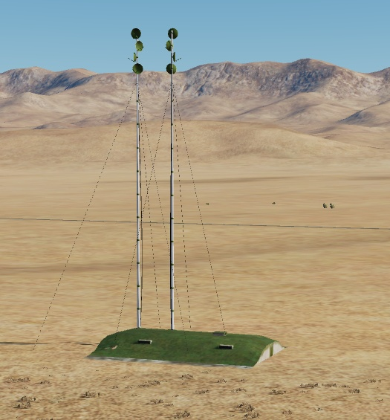
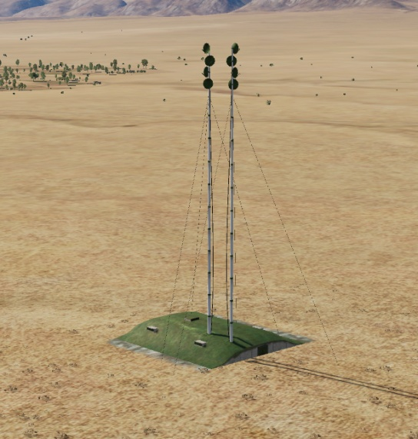
SECTOR COMMAND CENTER (SCC)
The sector command center is the centralized area where a air defense sector is controlled. All SAMs and EWRs in a region will be connected to the sector command center.
The air defense sector will also be supported by the overall IADS resources such as other EWRs, AWACS, air defense fighters flying CAP or interceptors on ground alert.
If the sector command center is destroyed, the sector will be cut off from other IADS resources, some SAMs may then be off permanently (they are not aware that the sector command center is destroyed), or they can be active all the time, making it easier to locate them SAMs in the sector for engagement with standoff precision munitions.
Example of a region command center seen on the right.
A
A
B
B
C
C
D
D
E
E
F
F
Back

Slide 7
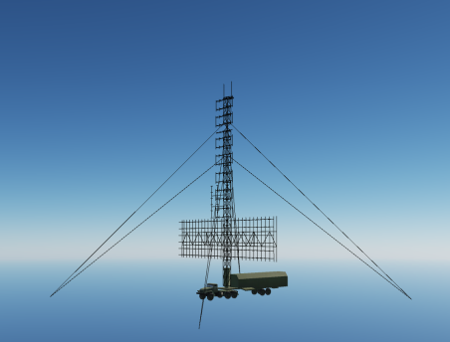
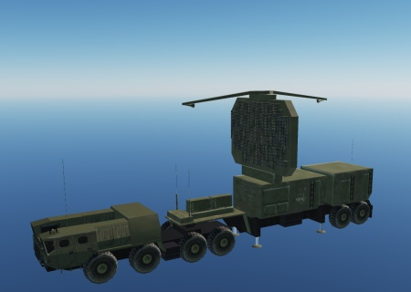
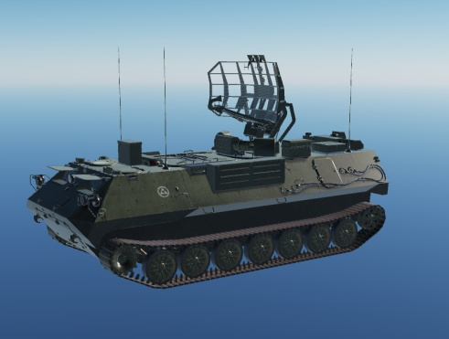
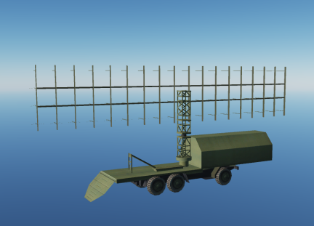
EARLY WARNING RADAR (EWR)
EWRs are critical parts of the IADS network. EWR scan the skies regularly and feed information to the sector command center or the IADS command center. This makes it possible for SAM sites to be dark (radar off), and only activating to fire a missile once they know a target is within range. This create a lethal combination as the first time a pilot may get a warning from the SAM is when it starts firing at the pilot.
EWRs may be on all the time, or be on at regular intervals to ensure good coverage.
EWRs is high value targets that is likely protected by point defense system and are placed within the umbrella of the IADS network.
EWRs are normally placed at locations which gives best possible coverage of the airspace in the sector.
By avoiding detection by EWRs it is possible to sneak in to a sector and conduct the mission without being shot at.
Large SAM sites such as the SA-10 have powerful radars that also can be used as EWR.
Examples of EWRs seen to the right.
A
A
B
B
C
C
D
D
E
E
F
F
Back

Slide 8
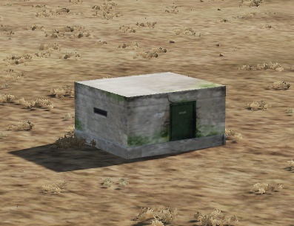
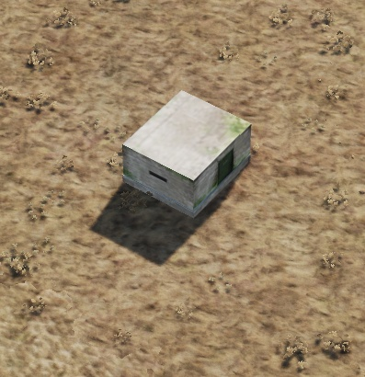
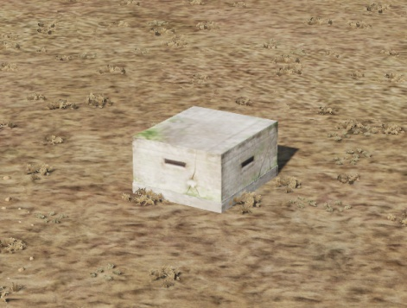
POWER SOURCE
Certain parts of the IADS network may require a external power source to function.
Many elements of the IADS, such as the smaller SAM systems have autonomous power and will not be affected by the destruction of power sources. But EWRs and IADS command center require minimum one power source to operate. Some elements may also have a backup power source to be able to function in case the primary power source is destroyed.
Examples of primary power source seen to the right.
A
A
B
B
C
C
D
D
E
E
F
F
Back

Slide 9
SAM SITE
SAMs is the primary threat to aircraft and helicopters.
SAM units are explained in INTREP VIS B-001 Generic Ground Force Structure v1.0, pages 46-57.
IADS will normally consist of multiple systems complementing each other. The larger systems (SA-10, SA-2, SA-11, SA-6) can be protected by point defense systems such as the Air Defence Forces Battalions/Batteries and Platoons.
SAMs in the IADS will move regularly, with a assessed interval as shown on the table to the right. SAMs will stay silent (dark= avoid emitting with their radars) as long as possible to avoid being targeted and to keep the element of surprise.
IADS SAMs movement intervals:
SA-11: Moves every 6 hours
SA-10: Static or moves every 24 hours
SA-6: Moves every 12 hours
SA-3: Semi static
SA-2: Semi static
Semi static: Launchers are static but the SAM system can be moved if required due to shifting priorities of the IADS commander.
A
A
B
B
C
C
D
D
E
E
F
F
Back

Slide 10
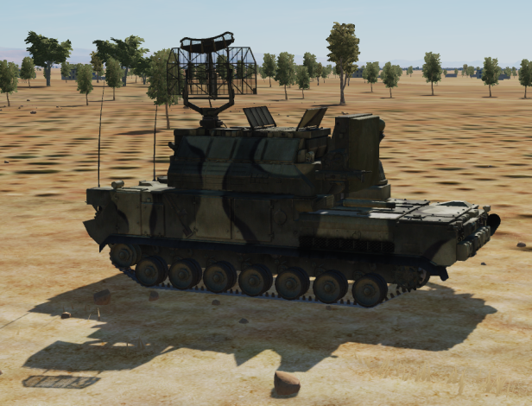
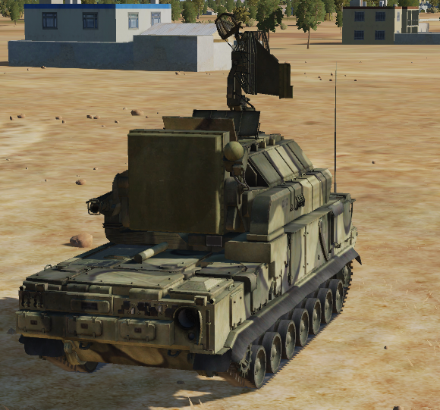
POINT DEFENSE
High Value Targets (HVT) such as EWRs, command centers or important SAMs will have a local point defense. The intention for the point defense is to be able to shoot down Anti Radiation Missiles (ARM) that are beeing launced at the HVT.
The only known point defense system is the SA-15.
It is assessed that if a point defense system is protecting a enemy radar, such as a EWR or SAM, the EWR or SAM may still operate even though a ARM is fired toward it. It will require multiple ARMs to flood the point defense in order to be able to shut enemy radars down if they are protected by point defense systems.
A
A
B
B
C
C
D
D
E
E
F
F
Back

Slide 11
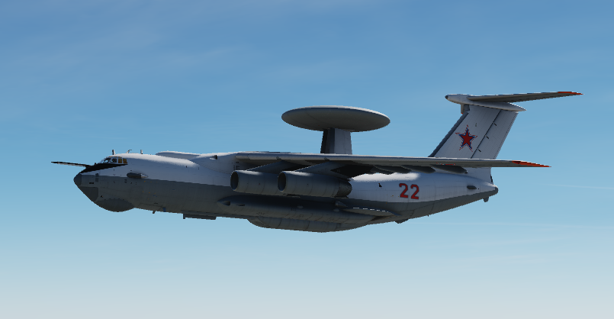
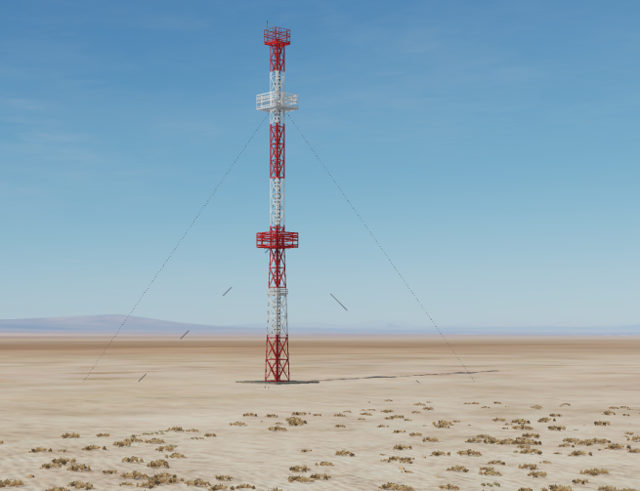
AWACS
AWACS can be a huge contributor to the IADS by providing coverage down into valleys and into areas where the EWRs are not able to detect aircrafts.
AWACS function in the IADS in a similar was as EWRs.
AWACS is limited in numbers and a very high value target if in the air.
AWACS is transmits its information into the IADS and the command center via a connection node, as shown on the picture to the right.
A
A
B
B
C
C
D
D
E
E
F
F
Back

Slide 12
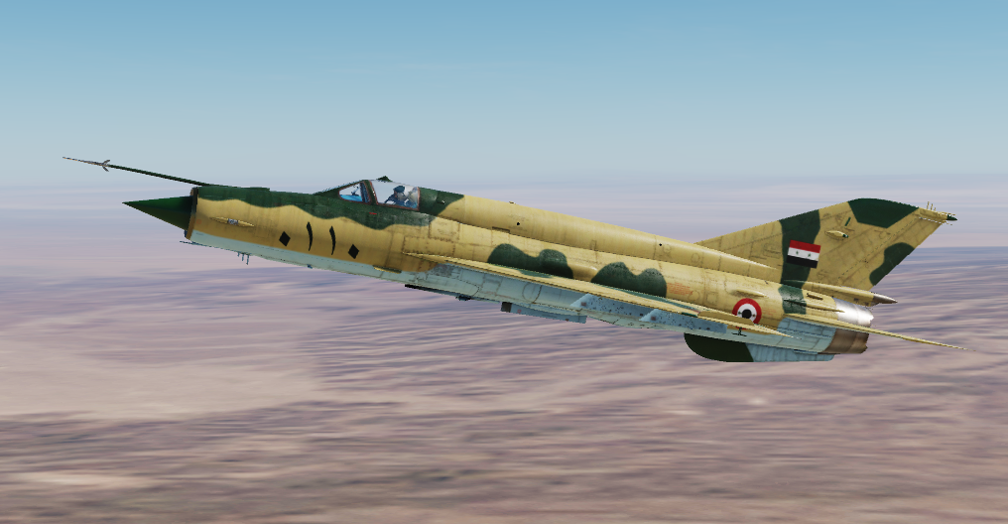
AIR DEFENSE FIGHTERS
Air Defense fighters flying either CAP mission, or a ground based alert, ready to scramble and intercept incoming fighters is a important part of any IADS.
Continous CAP mission require a high availability of aircraft and is likely only possible for limited time or a very few areas. A more resource friendly way of supporting the IADS is to have intercept aircraft on ground alert. This way, the aircraft can be on alert and ready to scramble in case EWR or other parts of the IADS detect incoming aircraft.
A
A
B
B
C
C
D
D
E
E
F
F
Back

Slide 13
IADS TACTICS
ARM defense
SAM sites and EW radars will shut down their radars if they assess that a ARM (Anti Radiation Missile) is heading for them. For this to happen, the SAM site has to detect the ARM missile with its radar.
SAMs will not shut down for each ARM launched in the air, but they will calculate if a missile is going to land close enough to their position, and if so, they will turn silent and stop feeding information to the ARM missile.
Point defense
If an ARM was launched on an emitter, other friendly radars that are close enough can detect the missile incoming and intercept it with their own weapons. For this are required more modern radars, that can pick up the radar cross section (RCS) of an ARM missiles. SA-10 and SA-15 are powerful enough to employ this tactic to shoot down ARMs. SA-10 systems are strategic systems and will not be used in a point defense role, while the SA-15 is often used in the point defense role.
A
A
B
B
C
C
D
D
E
E
F
F
Back

Slide 14
HOW TO NEUTRALIZE IADS
How to neutralise the IADS SEAD and DEAD missions are key to work against this systems, but this is how to direct them.
##Power Sources destruction Depending on the campaign ROE, the destruction of power plants could be allowed. Cutting power to the IADS will force all the SAM site to work autonomously, and being unable to feed each other informations, listen to EW, and coordinate with their command unit. This would result in all the SAMs turning on their sensors, and revealing all the information through the emitters.
##Command Centre destruction Beheading the network will result in general disarray and inability to cooperate, and forcing local commanders to take decisions on their own. Most likely SAMs will operate autonomously, or do nothing during the wait for new orders
##Comuncation Node Destruction If those are discovered and identified, the destruction of this nodes will degrade the ability of the IADS. Could force SAMs some connected via that node to function autonomously and not inside the network.
##EW Radar destruction Blinding the IADS means that they will be forced to rely on other radars with less power, or worse positioning, creating blind spots where to operate freely. SAMs sites could be forced to turn their radar on to try to locate possible threats, giving away their position.
##SAM destruction or suppression SAMs can be engaged with several HARMs or Standoff weapons. If a precise location is discovered, a precise standoff attack can be launched. With less information at hand, HARMs can be used to be launched on enemy radars, forcing them to turn off their emitters and go blind.
A
A
B
B
C
C
D
D
E
E
F
F
Back

Slide 15
PART 2: Syrian IADS

Slide 16
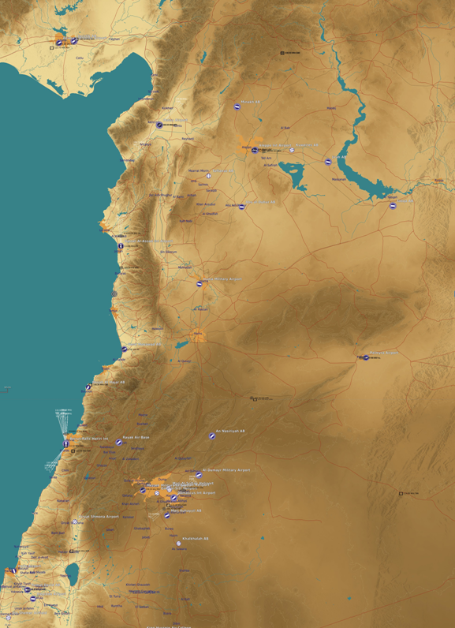
SYRIAN IADS ORGANIZATION
The Syrian IADS is organized in 3 separate regions: Syrian Air Defense Force Sector West (SYR ADF S W), Syrian Air Defense Force Sector East (SYR ADF S N) and Syrian Air Defense Sector South (SYR ADF S S).
The Syrian IADS is split into three elements:
First Interceptor aircraft on QRA duty protect the entire Syrian airspace.
Second large static SAMs such as SA-2 and SA-3 is used to protect key airfields and strategic locations such as Damascus.
The third element is mobile SAMs such as SA-6 and SA-11 which is used to fill gaps in the coverage. These systems are mobile to avoid being targeted by precision guided munitions.
The air force operates GCI/EWR system forms the top tier of the IADS, supporting fighters with GCI vectors, but also datalinking early warning information down to individual SAMs (GCI control from Sector Command Centres).
A
A
B
B
C
C
D
D
SYRIAN AIR DEFENCE FORCE REGION WEST
E
E
F
F
SYRIAN AIR DEFENCE FORCE REGION EAST
SYRIAN AIR DEFENCE FORCE REGION SOUTH
Back

Slide 17
SYR ADF SECTOR WEST
The Sector Command Center (SCC) for Region West is located IVO Abu Al Duhur Airbase.
ADF Sector West’s focus is to be the first line of defense for attacks coming from the West. In addition focus is to protect strategic important installations especially key airfields.
Additional SAM units from the Syrian Army and Republican Guard may also contribute to the air defense in sector, but they are not a part of the IADS, and will protect on a more ad-hoc basis based on their activity, availability and alert posture.
Sector West units:
831st SA–2 Regiment
8310 EWR BN
8311 SA-2 BN
8312 SA-3 BN
8313 SA-3 BN
8314A Air Defence Battery
841th SA–2 Regiment
8410 EWR BN
8411 SA-2 BN
8412 SA-3 BN
8413 SA-3 BN
8414A Air Defence Battery
851st SA-6 Regiment
8510 EWR BN
8511 SA-6 BN
8512 SA-6 BN
8513A Air Defence Battery
8520nd SA-11 Battalion
8520A SA-11 Battery
8521A SA-11 Battery
A
A
B
B
C
C
D
D
E
E
F
F
Back

Slide 18
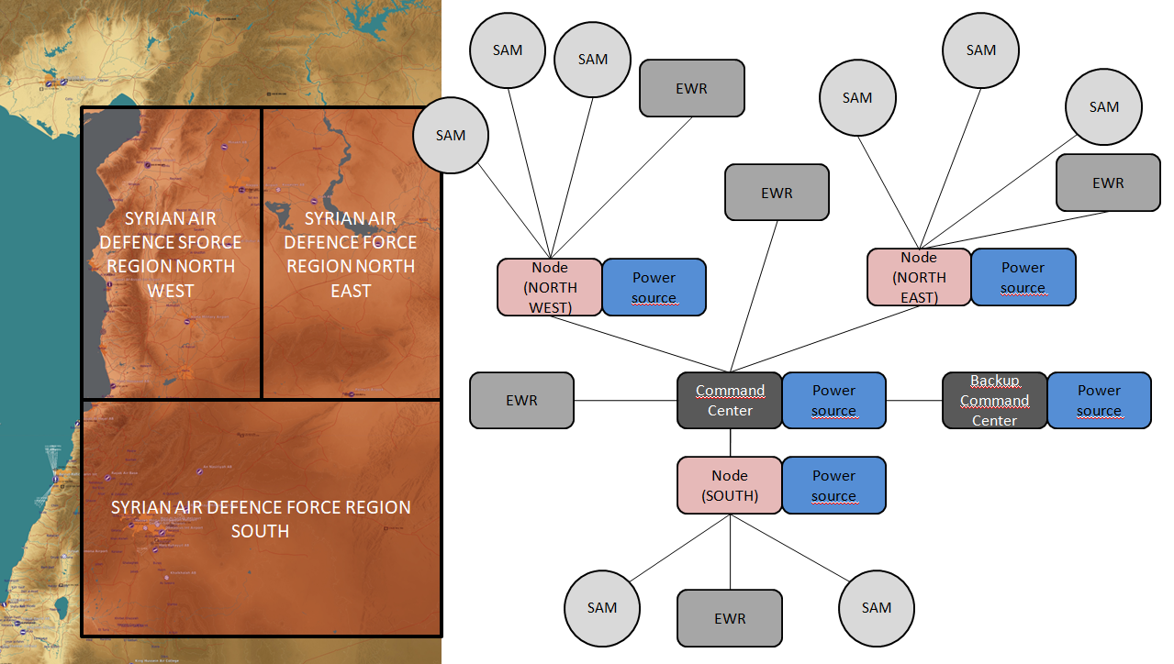
SYR ADF REGION EAST
The Syrian IADS is organized in the following way:
Second most important ADF region, due to military installations and chemical weapons sites
A
A
B
B
C
C
D
D
E
E
F
F
Back

Slide 19
SYR ADF SECTOR SOUTH
Syrian ADF Sector South is the most defended sector in Syria as it protects Damascus.
In addition to the units listed on the right, Damascus is also the location where the Command center for the entire Syrian IADS network is placed.(ADCC).
Damascus also houses the Sector Command Center (SCC).
ADF Sector South’s focus is to protect Damascus to keep the regime safe, as well as protect strategic important installations (airfields).
Additional SAM units from the Syrian Army and Republican Guard will likely also contribute to the defence of Damascus, but they are not a part of the IADS, and will protect on a more ad-hoc basis based on their activity, availability and alert posture.
Sector South units:
801st SA–2 Regiment
8010 EWR BN
8011 SA-2 BN
8012 SA-3 BN
8013 SA-3 BN
8014A Air Defence Battery
811th SA–2 Regiment
8110 EWR BN
8111 SA-2 BN
8112 SA-3 BN
8113 SA-3 BN
8114A Air Defence Battery
821st SA-6 Regiment
8210 EWR BN
8211 SA-6 BN
8212 SA-6 BN
8213A Air Defence Battery
8220nd SA-11 Battalion
8220A SA-11 Battery
8221A SA-11 Battery
A
A
B
B
C
C
D
D
E
E
F
F
Back

Slide 20
INTELLIGENCE GAPS
Provide a list of questions or gaps in intelligence, where taskings can be generated to collect information
INSERT MAP HERE
A
A
B
B
C
C
D
D
E
E
F
F
Back

